Slide 1
Sounds Fun
Mission 13

Slide 2

Pre-Mission Preparation
In this mission you will use CodeX as a controller to start and end a race. With batteries CodeX can go anywhere!
What is something you might want the CodeX to do or control?

Slide 3

Mission 13: Sounds Fun
Picking up good vibrations?
Previously you played mp3 files on CodeX
using the basic audio functions. But there
is much more you can do with sound on
this amazing device!
In this mission you will dive deep into the soundlib module.

Slide 4
Mission 13: Sounds Fun
Get GUI! You will also make a “graphical
user interface”, or GUI. It will give the user
a way to interact with CodeX.
Project Goals:
Play sounds and music in the background while code is running
Make sound effects
Control the pitch
Loop the sounds
Craft a GUI component

Slide 5

Objective #1: Race Day
A big cycling race starts in just a few hours. But the sound system is broken! If a solution isn’t found, the event will be canceled.
Nooooo! You have to save the day!
Your CodeX has lots of sound capabilities. And, you can plug the output into a guitar amp to get the volume up.

Slide 6
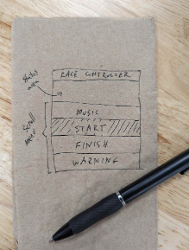
Objective #1: Race Day
Here are the requirements from the race officials. They made a napkin-sketch and
gave it to you.
The controller (CodeX) must:
Have an easy to use user interface (UI)
Loop the race theme music in the background (Play/Pause control)
Trigger the “Start” with a sound effect
Trigger the “Finish” with a sound effect
Give a “Warning” siren if needed

Slide 7
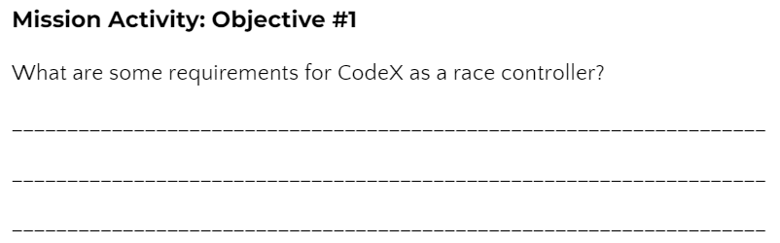
Mission Activity #1
DO THIS:
Go to your Mission Log and complete the question for Objective #1

Slide 8
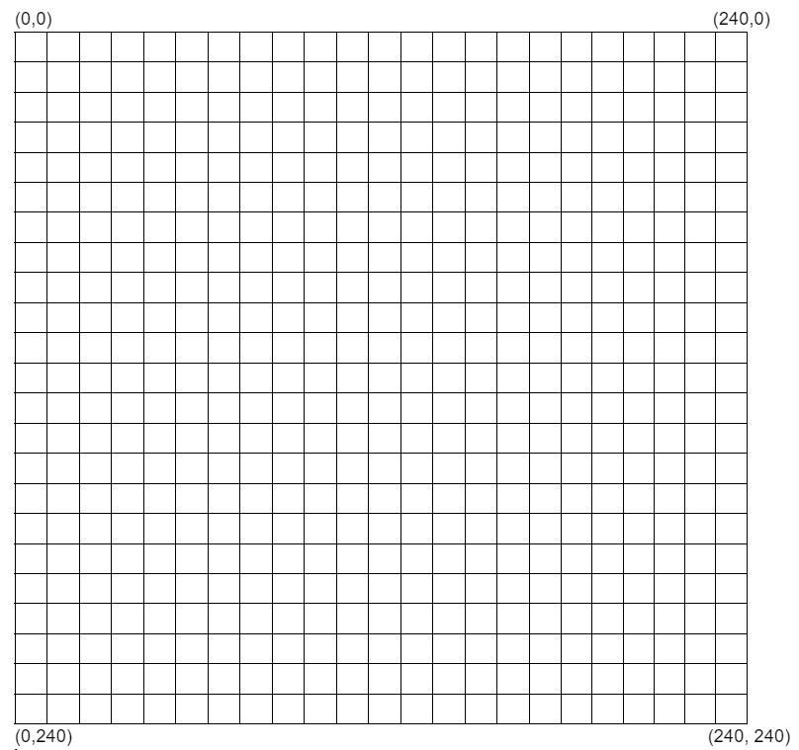
Objective #1: Race Day
x
You will use text and boxes to design your screen.
Think of the screen as one quadrant on a graph.
The origin is in the upper left corner
The x values go across, to the right
The y values go down, to the bottom
All x and y values are positive
y

Slide 9
Objective #1: Race Day
Use these commands to draw shapes. x and y represent the position on the graph (like an ordered pair).
display.fill_rect(x, y, width, height, color) &
display.draw_text(“text”, scale, color, x, y)
  For the controller title at the top
display.draw_rect(x, y, width, height, color)
  Box for each task (4 total)
display.draw_text(“text”, scale, color, x, y)
  Text for each task (4 total)
display.fill_rect(x, y, width, height, color)
  Filled box to indicate the task selection

Slide 10
Mission Activity #1
DO THIS:
Create a new file named Race_Control
Follow CodeTrek to
  Define a function for the screen layout
  Create a heading for the controller
  Draw rectangles and text for the menu options

Slide 11
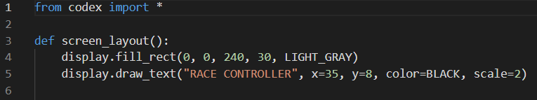
Mission Activity #1 - CodeTrek
DO THIS: Step 1 & 2
Define a function def screen_layout()
Draw a filled rectangle and text for the UI heading

Slide 12
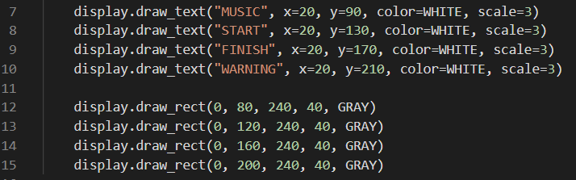
Mission Activity #1 - CodeTrek
DO THIS: Step 3
Complete the function by drawing text and rectangles for the menu options

Slide 13

Mission Activity #1 - CodeTrek
DO THIS: Step 4
AFTER the function, draw the dark blue filled rectangle that will show the selected menu option.
Then call the function.
Hint: x=0

Slide 14
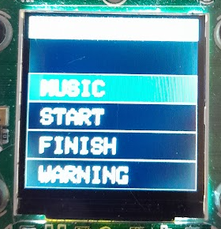
Objective #2: Getting Interactive
Your UI layout looks great! Now it’s time to scroll the buttons so the user can select different options.
Right now the selection is stuck on MUSIC
RACE CONTROLLER

Slide 15
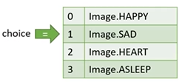
Objective #2: Menu List
Remember in the Personal Billboard mission you:
used a list to hold different items
scrolled through the list
used an index variable “choice”
You can do the same thing here!

Slide 16
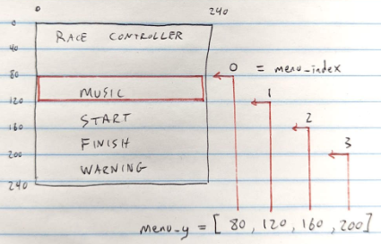
Objective #2: Menu List
This time your list will hold the y-coordinates where each rectangle needs to be drawn.
The list is “menu_y”
The variable “menu_index” points to the selection.
The x-coordinate is always 0

Slide 17
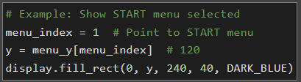
Objective #2: Menu List
You will add code like this:

Slide 18
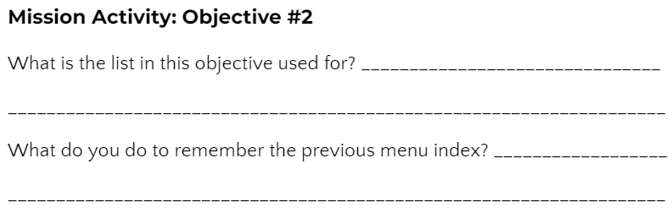
Mission Activity #2
DO THIS:
Go to your Mission Log and complete the questions for Objective #2

Slide 19

Mission Activity #2 - CodeTrek
DO THIS:
After the screen_layout() function:
Add the global variable menu_index
Add the menu_y list

Slide 20
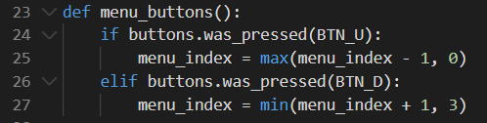
Mission Activity #2 - CodeTrek
DO THIS:
Just below the function screen_layout()
Define a function menu_buttons()
It will check if BTN_U or BTN_D was pressed and update menu_index
“max()” and “min()” keep the index at 0, 1, 2 or 3 without using an if statement.

Slide 21
Mission Activity #2 - CodeTrek
DO THIS:
Move the rest of the code into a while True: loop
Use a variable prev_sel to keep track of the previous selection
Call menu_buttons()
If the new menu_index is different from the previous index:
  Update the DARK_BLUE rectangle
  Call screen_layout()

Slide 22
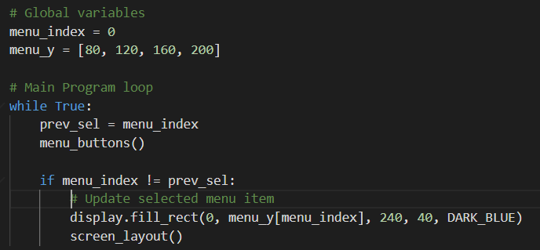
Mission Activity #2 - CodeTrek
DO THIS:
When you run the code, and press a button, you WILL get an ERROR!

Slide 23
Objective #3: Bug Bashing
So what’s up with this error message?
Local Variables
When you assign (update) a variable inside a function, Python assumes it is local.
A local variable is “private” to the function.
It is a separate variable, even if it has the same name as another variable outside the function.
It only exists while the function is running.
It can’t hold its value between function calls.

Slide 24
Objective #3: Bug Bashing
Global Variables
Exist for the entire life of the program
Defined outside any function
Can be used inside any function
If the variable changes (gets updated), you must use a global statement

Slide 25
Objective #3: Bug Bashing
So what happened?
The menu_buttons() function changed the value of menu_index
But Python thinks menu_index is a local variable!
And a local variable doesn’t exist until it is first assigned a value in the function
But the max() and min() functions tried to read the value of menu_index before one was given
Instead, make menu_index global by using the global statement.

Slide 26
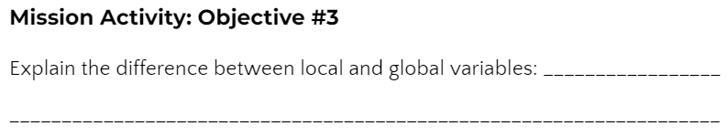

Mission Activity #3
DO THIS:
Go to your Mission Log and complete the questions for Objective #3

Slide 27
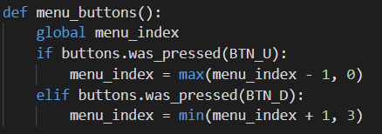
Mission Activity #3
DO THIS:
Add the global statement to the function to keep menu_index global and not local.
The menu will still not work as expected. We will fix that!

Slide 28

Globals and Locals
During this mission you have learned about the local and global variables.
Answer 2 quiz questions about the concept.
CODEX
QUIZ

Slide 29
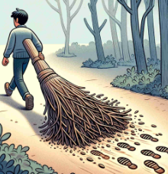
Objective #4: Covering Your Tracks
Oh dear! Your program has yet another problem. Your menu selection is leaving big footprints behind!
You are keeping track of your previous selection (prev_sel)
Use it to “erase” the rectangle and then redraw it around the new selection (menu_index)

Slide 30
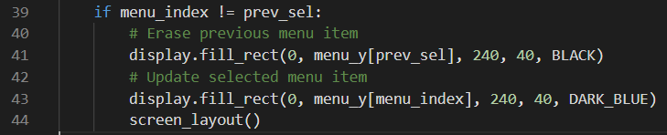
Mission Activity #4 - CodeTrek
DO THIS:
Draw a BLACK rectangle at prev_sel to “erase” the previous menu selection
<continued>

Slide 31
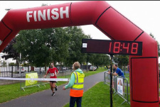
Objective #5: Add Some Action!
Now that your menu-scrolling is on point, it’s time to add a way for the user to trigger the selected action.
For now just display a message when BTN_A is pressed.

Slide 32
Objective #5: Add Some Action!
If you look closely at the napkin sketch there was a “status area” just above the menu.
Put some text there for each menu action
Soon you will add the sounds!

Slide 33
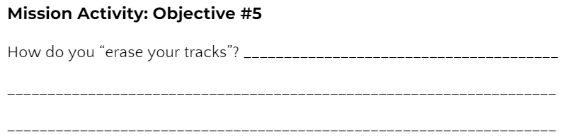
Mission Activity #5
DO THIS:
Go to your Mission Log and complete the question for Objective #5

Slide 34

Mission Activity #5 - CodeTrek
DO THIS:
Define a function that shows a message for the selection.
Use a parameter for the message.

Slide 35
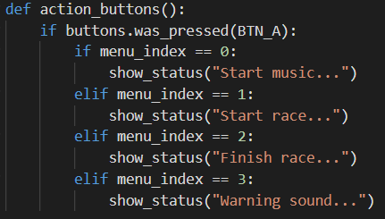
Mission Activity #5 - CodeTrek
DO THIS:
Define another function that calls show_status() and passes in the message to display.
The variable menu_index points to the items in the menu

Slide 36
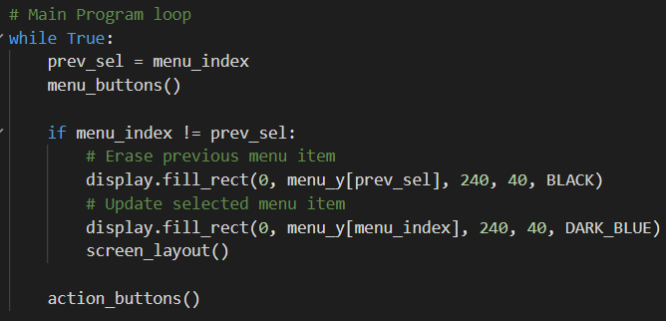
Mission Activity #5 - CodeTrek
DO THIS:
Call action_buttons() in the while True: loop (but not the if statement)
Be careful with your indenting!

Slide 37
Objective #6: Make a Good First Impression
The menu system is looking good, but it could be more user-friendly.
The user has to press BTN_U or BTN_D before anything is displayed.
There are no instructions about what buttons to press.

Slide 38
Objective #6: Make a Good First Impression
You should have a program initialization that sets the display and global variables when the code is first run.
Use a global Boolean variable to indicate initialization
  init = True
Call screen_layout() to draw the whole screen plus menu selection when the program runs

Slide 39
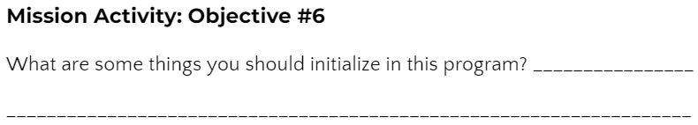
Mission Activity #6
DO THIS:
Go to your Mission Log and complete the question for Objective #6

Slide 40
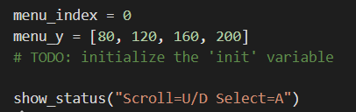
Mission Activity #6 - CodeTrek
DO THIS:
Initialize the Boolean init variable to True
Call show_status(“Scroll=U/D Select=A”)
This is before the main loop, so it only runs once when the program first starts.

Slide 41
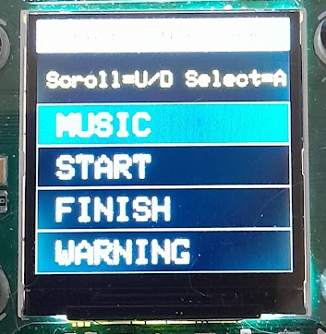
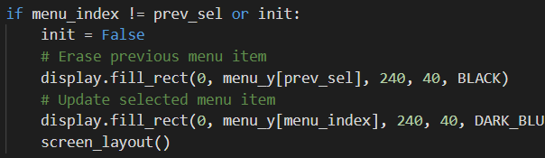
Mission Activity #6 - CodeTrek
RACE CONTROLLER
DO THIS:
Modify the if statement to also check init
Update init to False inside the if statement
  You only need it to be True for the first, or initial, run

Slide 42
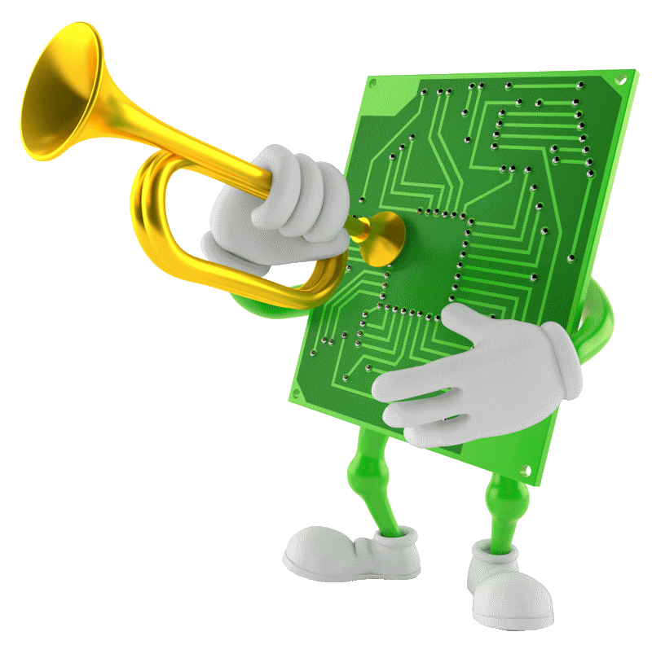
Objective #7: START!
Now it is time to put some ACTION in your menu actions!
To start the race you want a punchy distinctive sound.
Something like a bugle call.
Instead of playing an MP3 file, create your
own tones and change the pitch (frequency)
with code!

Slide 43
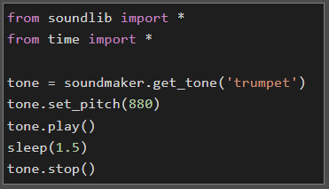
Objective #7: The soundlib Module
Your CodeX has an awesome Python module (or library) for creating music and sound effects.
Import the soundlib module.
Use soundmaker to get a tone or play an MP3 file.

Slide 44
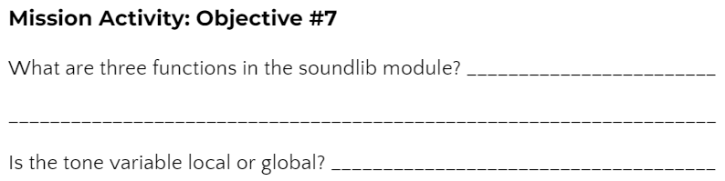
Mission Activity #7
DO THIS:
Go to your Mission Log and complete the questions for Objective #7

Slide 45
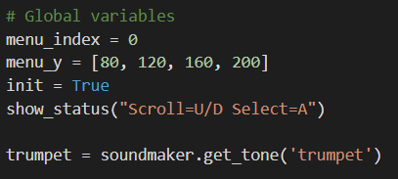
Mission Activity #7 - CodeTrek
DO THIS:
Define a global variable for the tone
  Each call to get_tone() gets a new sound that can be played independently.
  You can have up to 16 tones playing at the same time!
You can use either double quotes or single quotes for a string.

Slide 46
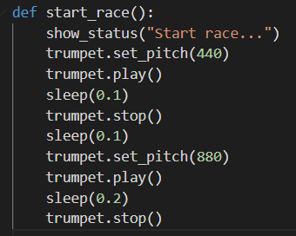
Mission Activity #7 - CodeTrek
DO THIS:
Define a function to start the race.
  Keep the sound effect simple.
  You can customize the sound later.

Slide 47

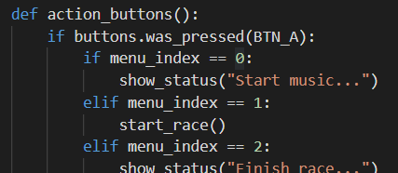
Mission Activity #7 - CodeTrek
DO THIS:
Remember your imports!
Call the start_race() function in action_buttons() for menu_index == 1

Slide 48
Objective #8: More Fanfare!
Now add some excitement to the fanfare starting sound.
Repeating the first tone several times is a good lead-in
And you know how to do that without copying and pasting a bunch of times, right?!
You need to use a loop!
But this time you can make the code even more simpler…

Slide 49
Objective #8: For Loop
The for loop is made for looping across a range of numbers, or iterating over a list.
Use the built-in range() function to specify the numbers to loop across.
The for loop saves you the trouble of initializing and updating the loop control variable.
This is because it automatically increments the control variable.

Slide 50
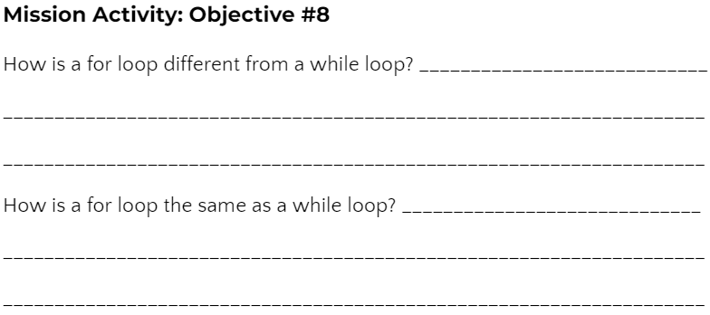
Mission Activity #8
DO THIS:
Go to your Mission Log and complete the questions for Objective #8

Slide 51
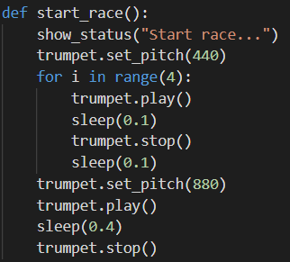
Mission Activity #8 - CodeTrek
DO THIS:
Add a for loop to the start_race() function.
Play some sounds in the function.
  Try it as shown,
  Then feel free to get creative!
  You can even add another for loop.

Slide 52
For Loops
During this mission you have learned about the using a for loop.
Answer 2 quiz questions about the concept.
CODEX
QUIZ

Slide 53
Objective #9: Make Some Music!
Now write code for the MUSIC menu option.
Playing an MP3 in the background
With the soundlib module, you have a new way to play MP3 files.
It is a non-blocking function, so your code can continue executing commands while the sound keeps playing.
The audio.mp3() command you used in Mission 5 is a blocking function, and no code was executed while the file played.

Slide 54
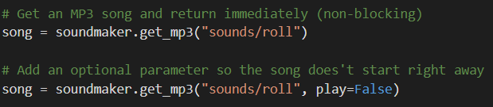
Objective #9: Make Some Music!
The new command to use is:

Slide 55
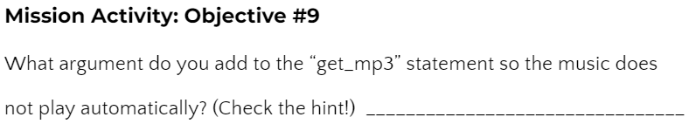
Mission Activity #9
DO THIS:
Go to your Mission Log and complete the question for Objective #9

Slide 56
Objective #9: Toggling On/Off
When the user selects MUSIC, it should either turn the music
ON or OFF.
This depends on whether the music is playing (True or False).
So you can use a Boolean variable and keep track.
When the MUSIC button is pressed, the state can flip:
  True -> False or False -> True
That is exactly what the not logical operator does.
You will often use this operator when you need to toggle
(or flip) a Boolean value.

Slide 57
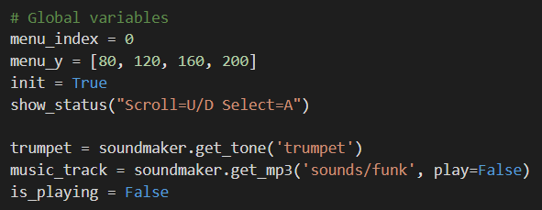
Mission Activity #9 - CodeTrek
DO THIS:
Add two global variables:
one for the MP3 file and one for the Boolean variable

Slide 58
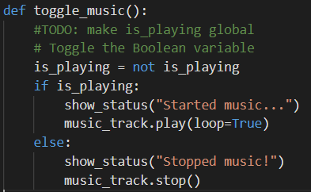
Mission Activity #9 - CodeTrek
DO THIS:
Define a function to play the music.
Use the Boolean variable to start and stop the music.

Slide 59
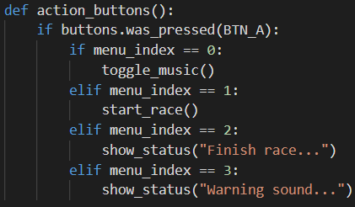
Mission Activity #9 - CodeTrek
DO THIS:
Call the toggle_music() function when MUSIC is selected.

Slide 60
Blocking and Toggling
During this mission you have learned about blocking and non-blocking functions, and about toggling a Boolean variable.
Answer 3 quiz questions about these concepts.
CODEX
QUIZ

Slide 61
Objective #10: The Sound of Victory
It is time for you to craft another sound.
The next one will be played when a racer crosses the finish line.
It should be exciting and inspiring - a celebration of effort!
The START sound used a for loop to repeat a tone. Now try changing the frequency inside your loop using set_pitch().
The CodeTrek will lead you to a pretty cool sound. But you can do better and make it your own!

Slide 62
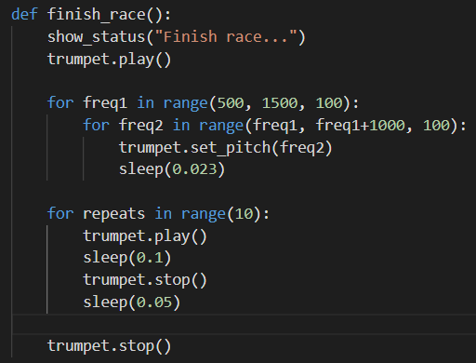
Mission Activity #10 - CodeTrek
DO THIS:
Define a function to finish the race with a victory sound.
  Use a for loop to change the frequency of the tone.
  Use a for loop to repeat a tone several times.

Slide 63
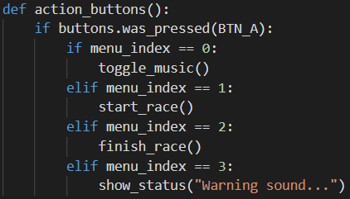
Mission Activity #10 - CodeTrek
DO THIS:
Call the function finish_race() when FINISH is selected.

Slide 64
Objective #11: Warning Alert
If there is a problem on the race course, or some danger to warn the riders about, how will the race officials get their attention?
Create a sound effect that makes people take notice!
Use the soundlib feature: glide()
The glide(new_pitch, duration) function is an easy way to ramp the pitch from the current pitch to a new pitch over a specified amount of time (duration).
This is easier than using a loop, plus it is non-blocking.

Slide 65

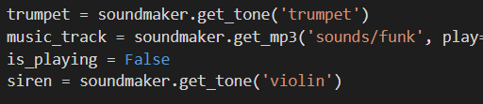
Mission Activity #11 - CodeTrek
DO THIS:
Define a new tone for the sound effect.
  You can select any tone from the list.

Slide 66
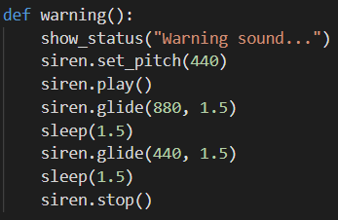
Mission Activity #11 - CodeTrek
DO THIS:
Define a function for the warning.
  Use the glide() function.
  It takes two arguments:
  new_pitch is where it will end
  duration is how long it takes to get there.
  You still need to sleep() while it is gliding because it is non-blocking.

Slide 67
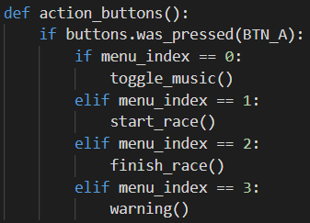
Mission Activity #11 - CodeTrek
DO THIS:
Call the function warning() when WARNING is selected.

Slide 68
Post-Mission Reflection
Read the “completed mission” message and click to complete the mission
Complete the Mission 13 Log

Slide 69
Clearing your CodeX
Go to FILE -- BROWSE FILES
Select the “Clear” file and open it
Run the program to clear the CodeX

